Slide 1

SALES INSIGHTS OF ABC HARDWARE COMPANY
By:- Akshay Kharche

Slide 2
PROBLEM STATEMENT
ABC hardware company which is headquartered in Delhi is continuously experiencing a decline in sales.
The sales director of the company is worried and contacts the regional sales managers for the reason.
The regional sales managers share some lengthy sales record Excel files to the sales director.
The sales director is unable to comprehend through all the data to find the reasons for the decline in sales.
He wants to stop the declining trend is the sales.

Slide 3
OBEJCTIVE
To unlock sales insights that are not visible before sales team for decision support and automate them to reduce manual time spent in data gathering.

Slide 4

Steps taken in the process
DATA COLLECTION
CLEANING OF DATA
MODELLING OF DATA
DATA VISUALIZATION

Slide 5

DATA COLLECTION
The data used here is obtained in the form of SQL-Text File.
The sample data is received from one of the GitHub pages.
All the properties of data is being viewed in MY-SQL Workbench 8.0.
The queries used in this project is attached in the readme file.

Slide 6

DATA CLEANING AND TRANSFORMATION
While querying the data I found some errors which were filtered then in Tableau.
The purpose of this data was to bring sales insights of Indian Market but there were 2 instances in the data (i.e. New-York & Paris) which were not required for analysis.
In Sales Transaction table there were some values with -1 and 0 sales amount which is practically not possible.
Most transaction present in the table were INR but there were some USD transactions which were then converted to INR by creating a new calculated field named “Normalized sales amount”.

Slide 7

DATA MODELLING
This process was executed in Tableau as the data had 5 tables named customer, market, transaction, date, product.
This process is done to find relationships between the different table in the same database.
In this all the tables are having one common column type between them.
All relationships are 1-1 in nature.
The data model follows star schema.
I have attached the image on the next slide.

Slide 8
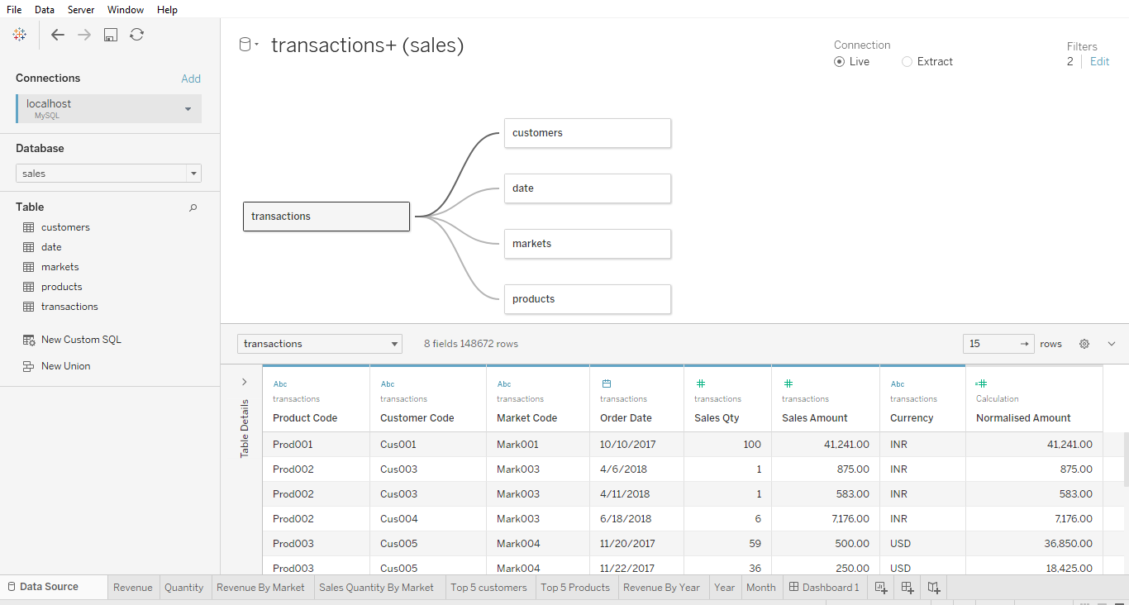

Slide 9
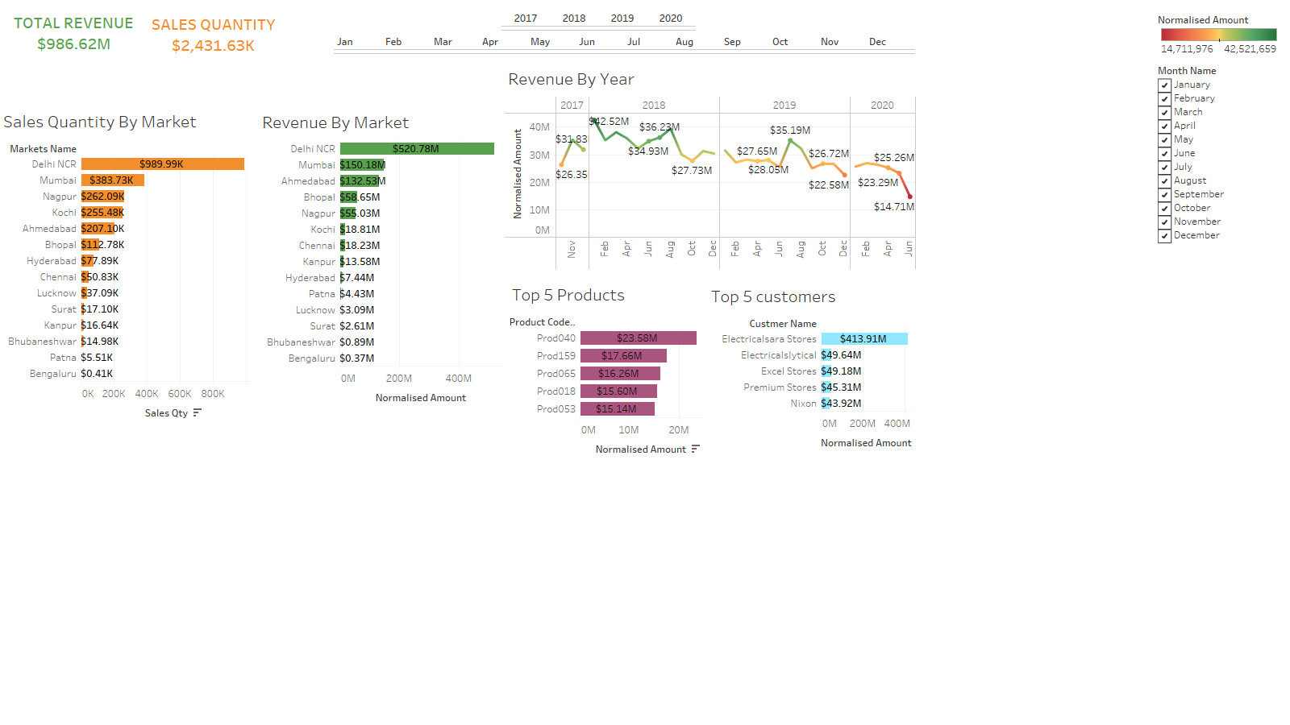
OVERALL SALES FROM (2017-2020)

Slide 10
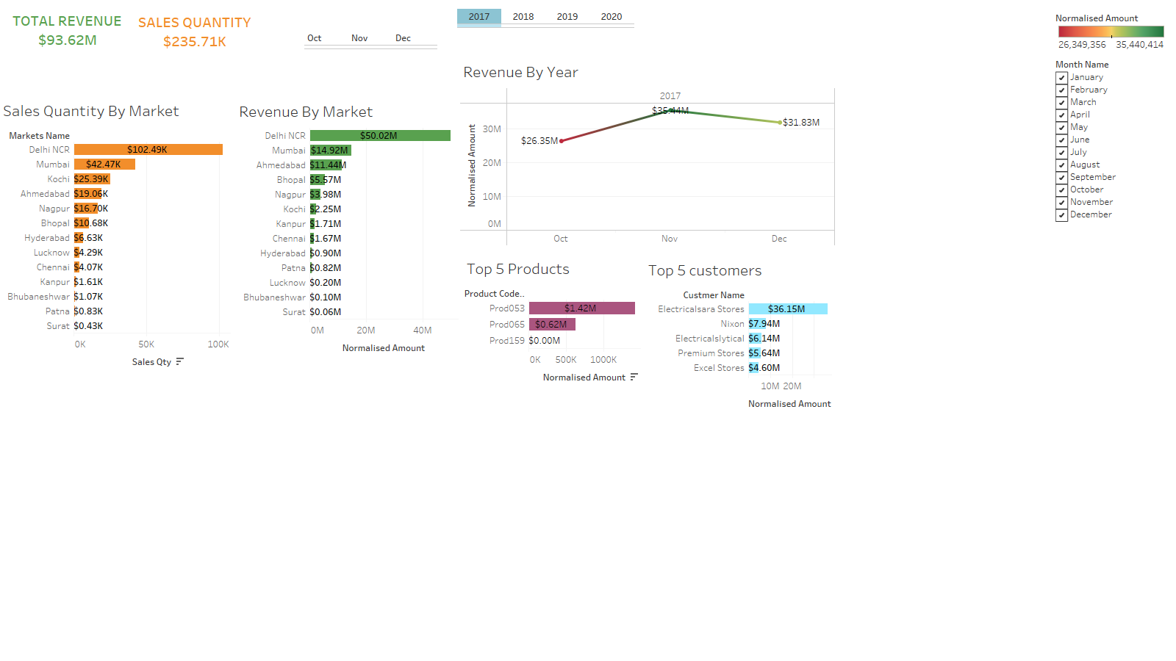
SALES IN 2017

Slide 11
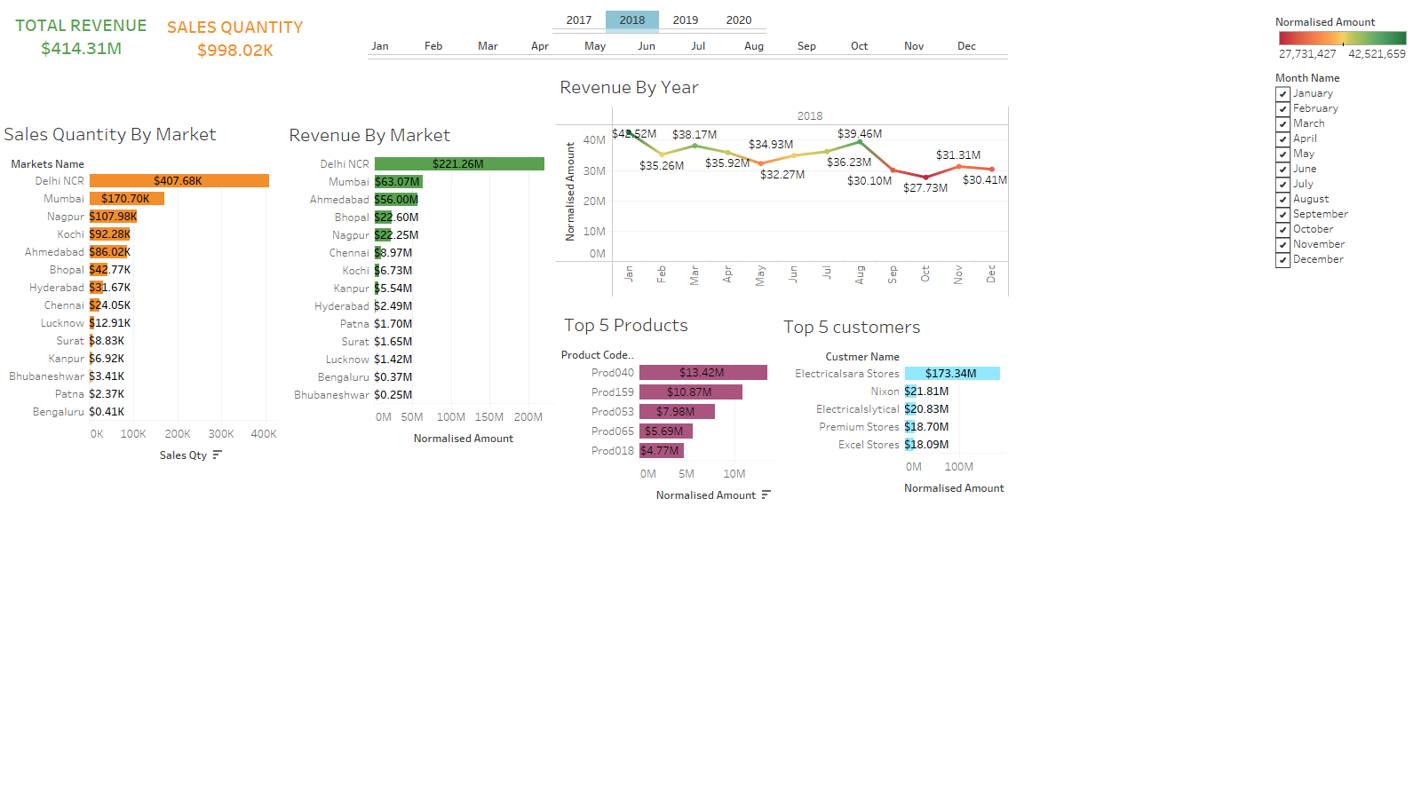
SALES IN 2018

Slide 12
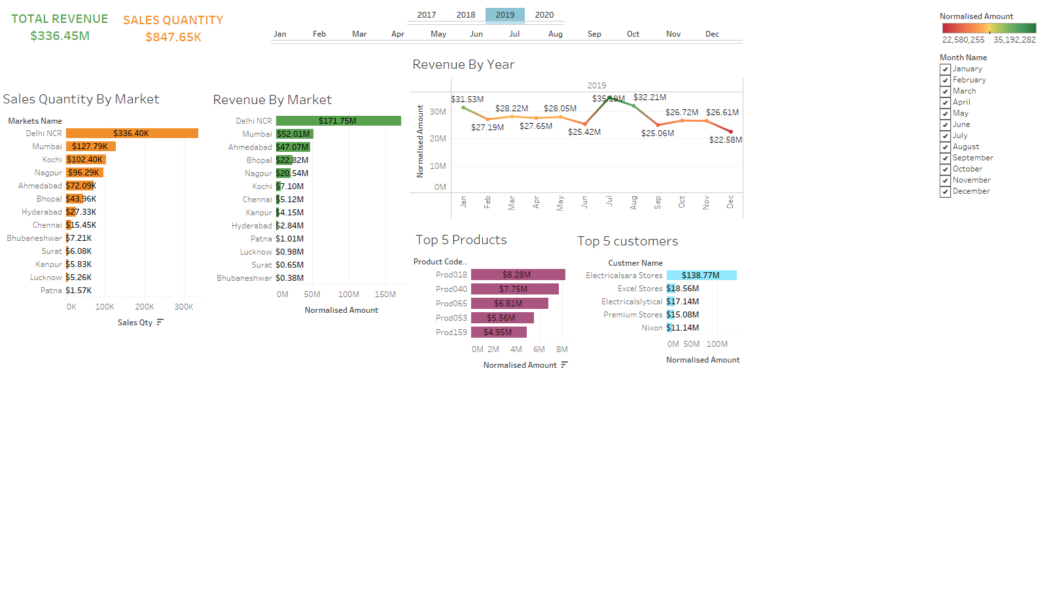
SALES IN 2019

Slide 13
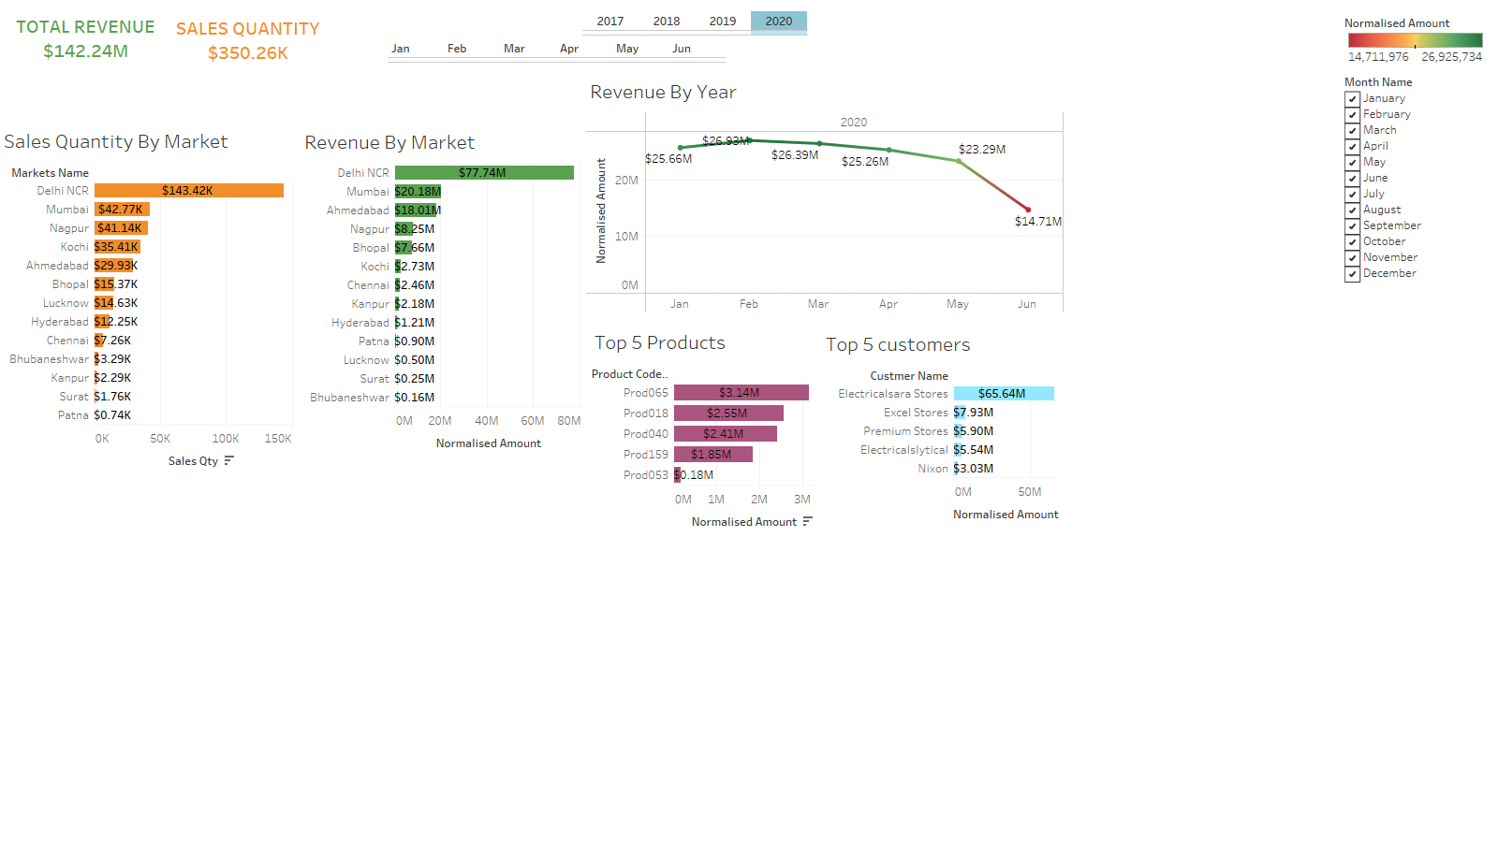
SALES IN 2020

Slide 14
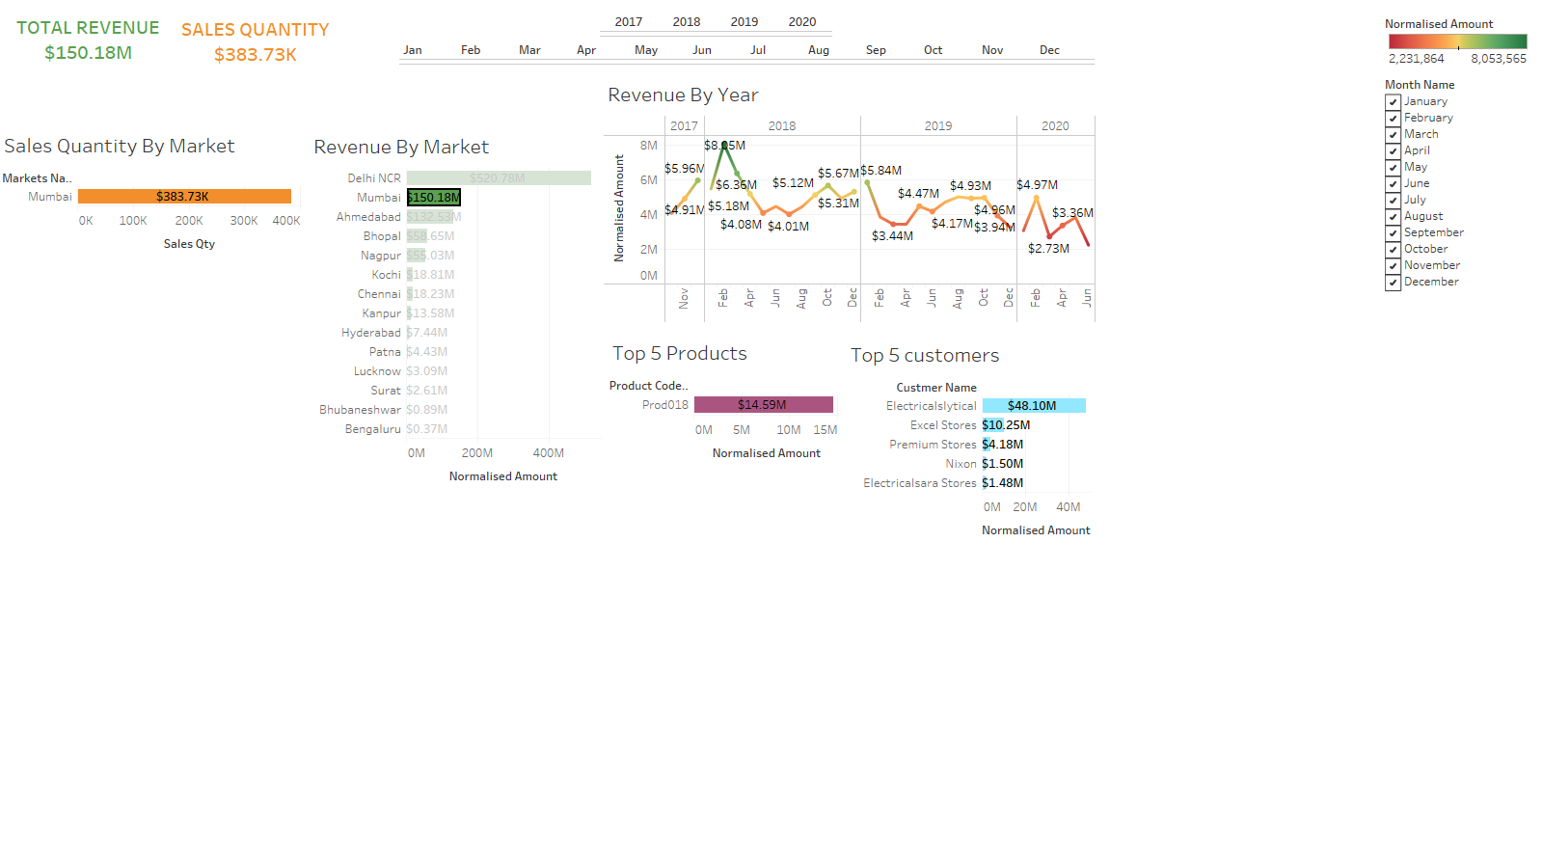
TOTAL REVENUES IN MUMBAI REGION

Slide 15
CONCLUSION
In this dashboard we can now actually analyze, how we can increase our sales gradually and specifically in which region we need to keep a close check.
The concerned person can now gather real time insights from dashboard time to time and make some correct data driven decision which may boost the sales of the company.
One can focus particularly on specific zones/products where sales have gradually declined and come up with some exciting offers to boost sales.

